Slide 1
CompuTrack by Stealing Beauty
Anthony Ma
James Russo
Jon Strassel
Matt Borel
Adam Miller

Slide 2

Purpose
RAM Computers
Customer management
Ticket organization and prioritizing
Inventory tracking

Slide 3
Functions
Log-in system
Customer/ticketing database
  Create and edit customers
  Prioritize and sort tickets
Inventory database
  Add and remove items
  Quantities

Slide 4
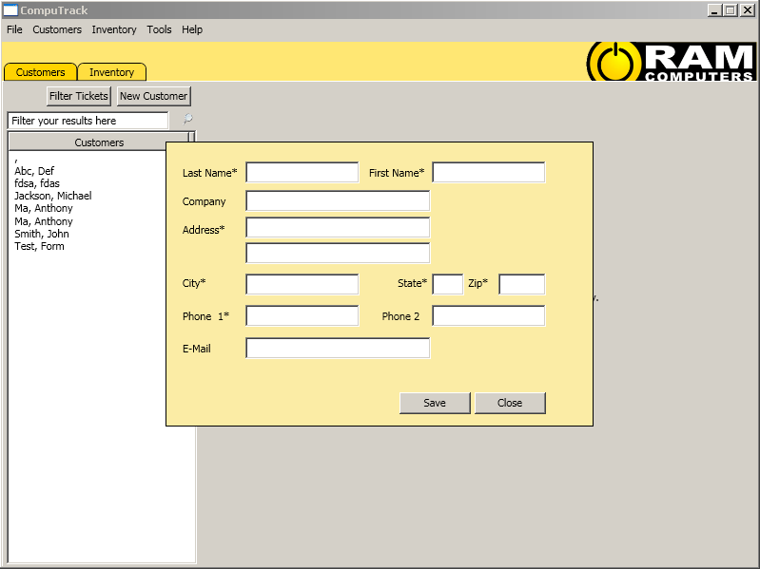
Customers
New customer box
Customer list from database

Slide 5
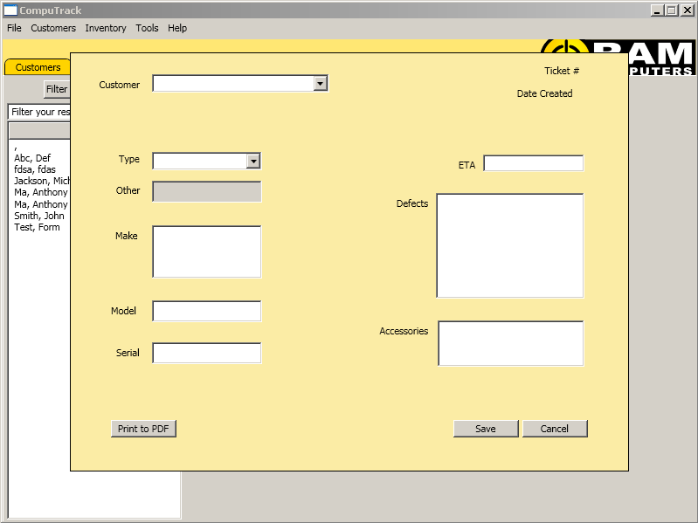
Ticketing
Create a new ticket
Print new ticket to PDF

Slide 6
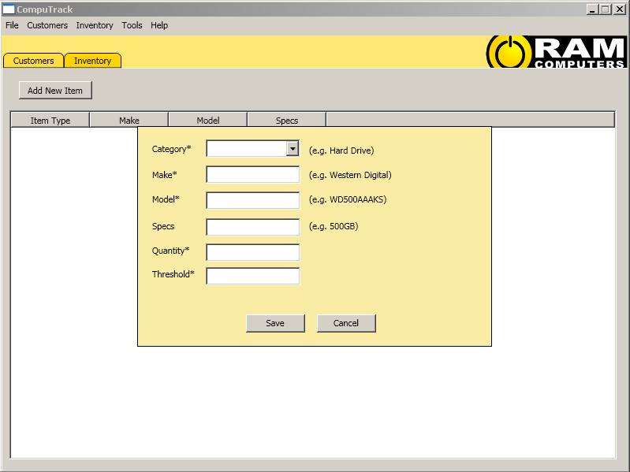
Inventory
Add item to database
Quantity and threshold for e-mail alerts

Slide 7
Vision
Create accessible and easy ticketing
  Filtering by priority and customers
  PDF exporting and printing
  Quickbooks integration (possibility)
Manageable inventory
  Quantity updates with e-mail alerts
  Sortable lists
  Specific details (specs, interface, etc.)

Slide 8





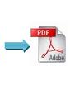
Tools

Slide 9
Conclusion
CompuTrack makes managing customer information easy for RAM employees
  Less time sorting problems
  More time fixing problems
Care-free stocking
  CompuTrack will keep you updated

Slide 10
Conclusion
Questions?

